Slide 1
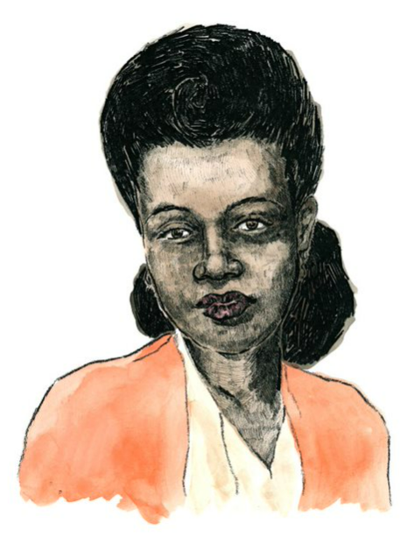
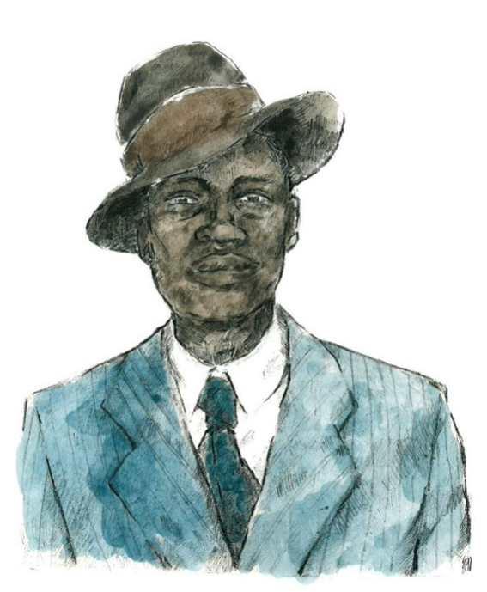
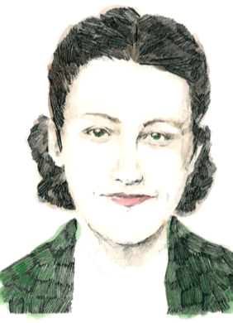
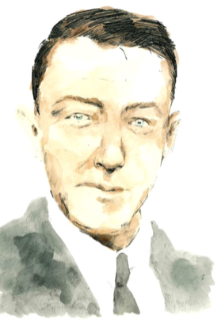
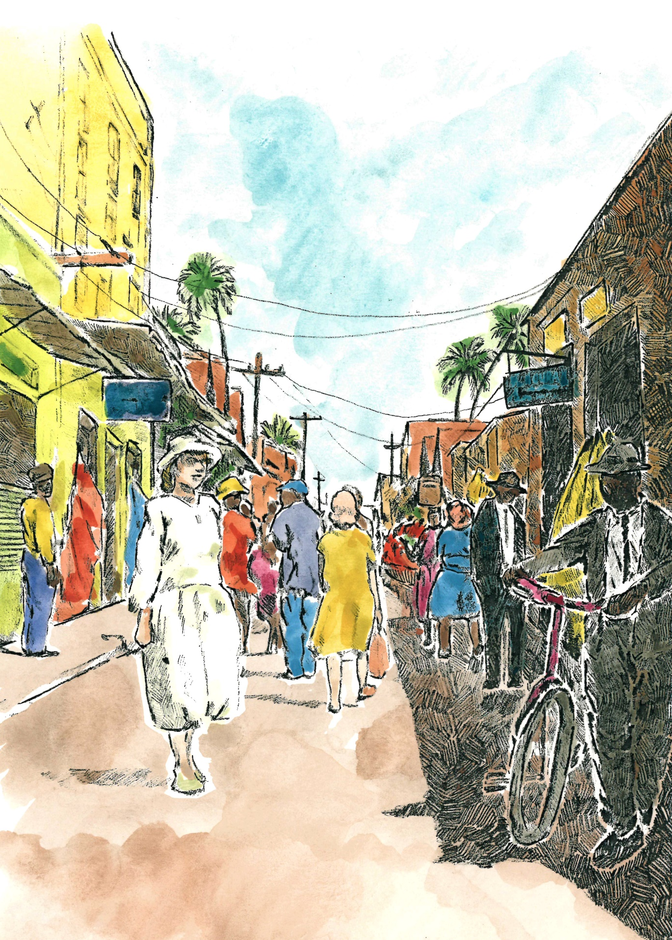
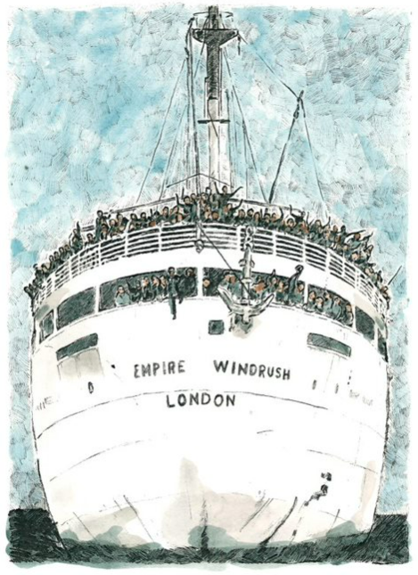
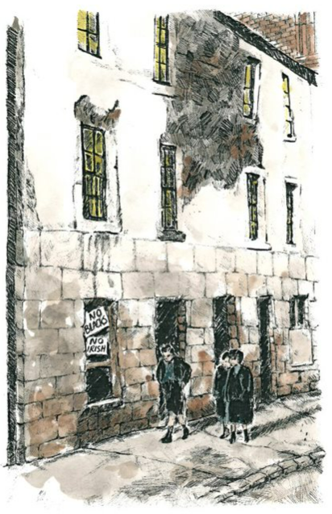
‘Small Island’ by Andrea Levy: Knowledge Organiser
About the play
Small Island is a novel written by Andrea Levy. In 2019, it was adapted into a play by Helen Edmunson. Although a work of fiction, Small Island takes place in the 1920s - 1940s. It tells the story of Hortense and Michael who emigrated from the Caribbean to England on the Empire Windrush in 1948. It shows the relationships they form, and the challenges they face starting a new life in a new country.
Characters
 | Hortense is a Jamaican woman. As a child she is given away by her mother in the hope that she has a better life. She is clever and proud. At the beginning of the play, Hortense has strong views about morality and the world. Hortense marries Gilbert not because she loves him, but so that she can go to England and fulfil her ambition of becoming a teacher in a country where she will be respected - ‘no-one will feel sorry for I’. Hortense struggles to adjust to the reality of life in England as her dreams of being a teacher are rejected. At the end of the play, Hortense’s feelings for Gilbert transform into love and pride at the end of the play when he addresses Bernard after his racist outburst.
 | Gilbert is a Black Jamaican man.​ His ambition is to become a lawyer in England.​ Gilbert is intelligent, charming and kind. Like Michael, he joins the RAF during The Second World War. Gilbert is a positive character who, like Hortense, has to adapt to the adverse situations he finds himself in. At the end of the play, Gilbert becomes mature and responsible by adopting baby Michael as his own with Hortense. He also realises that Hortense is worth ‘more than the price of a ticket’ to England. He ends the play with dignity and Hortense’s admiration.
 | Queenie is a British woman. At the start of the play, Queenie dreams of romance and having her own family. Queenie marries Bernard, but she is unhappy in her marriage. She says ‘It’s not what I imagined for myself’. Queenie is overwhelmed by the stigma of raising a black child. At the end of the play, she gives baby Michael away saying, ‘You know what? I don’t think I’ve got the guts for it’.
 | Bernard is an English man.​ Bernard is quiet, nervous and old-fashioned.​ His ambition is to impress Queenie. Bernard is hostile to anyone who’s not of his own race or class. Bernard typifies the racist attitudes that were prevalent in post-war Britain. His unwillingness to change his attitude makes him an unsympathetic character.
Key words
adversity - an extremely difficult situation adverse – extremely difficult
ambition – an ambition is something you want to achieve in life
Colony - A country that is ruled by a foreign nation is called a colony.
Dignified – if you are dignified, you are worthy of honour and respect.
Discriminate - to treat someone or a group of people unfairly because of their sex, race, religion or disability.
Euphemism – a euphemism is any phrase that hides another meaning.
Stigma - a set of negative and often unfair beliefs that a society or group of people have about something.
Stagecraft
A play is written to be performed in front of an audience.
A play is divided into acts and scenes.
A change in scene shows a change in place or a change in time.
The end of an act is more significant than other moments in a play.
Stage Directions tell us a lot about a character’s feelings and motives.
Characters can talk to the audience to reveal their thoughts, feelings, and memories.
Tableau – A tableau is when some of the actors freeze in the middle of the action. It reveals a character’s thoughts or feelings at a particular moment.
Events in the play: Act One |  |  | Events in the play: Act Two
 | The play opens in Jamaica - 1939. Hortense prepares for the arrival of a hurricane and tells her story. The hurricane hits. Michael appears, shoving Hortense out of the way and rushing to passionately kiss Mrs Ryder. | We then move to England – 1941. Queenie rents out rooms in Bernard’s house to soldiers. There is an instant attraction between Queenie and Michael. Hortense says she will lend Gilbert the money for the passage to England, if he marries her and sends for her once he has a place to live in England. |  | The play ends in London- 1948. Gilbert and Hortense are discriminated against by colleagues, neighbours and Bernard. Queenie gives birth to Michael’s baby. Queenie hands her baby to Hortense and Gilbert. They promise they will be proud of the child and he will be loved.

